Slide 1
Where in the US Should Taylor Move?
Tongchen He, Maria Hart, Cameron Song and Taylor Shaw
Notes:
Taylor is wondering where she should move so we found a website called Teleport that ranks cities based on 17 different factors and we analyzed that data based on what was most important to Taylor in her moving decision.

Slide 2
Cities Studied
Chicago | St. Louis | Boston | Austin
Seattle | Los Angeles | Las Vegas | Denver
Philadelphia | Honolulu | Nashville | Miami
New Orleans | Raleigh | Minneapolis | Detroit
Phoenix | San Diego | New York City | Washington, DC

Slide 3
Top Factors
Environmental Quality
Cost of Living
Education
Commute
Safety
Notes:
Since our data source has 17 different factors that go into their Overall Score, we chose which factors are most important to Taylor. The top of the list are Environmental Quality and Cost of Living, followed closely by Education, Ease of Commute, and Safety. These factors are ranked by Teleport based on other data, like water quality, soil quality, average costs for apartments and homegoods, traffic handling score, gun-related deaths, and international student assessment rankings.

Slide 4

Cities by Environmental Quality
Rating based on air quality, water quality, cleanliness and greenery

Slide 5
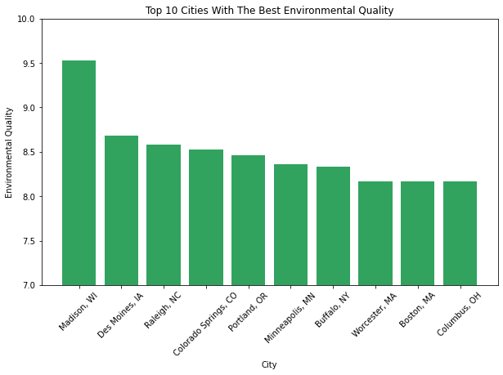
Notes:
Taylor’s top factor for moving is Environmental Quality because she’s very concerned about having fresh water to drink and the way that air quality can affect her health. So the first question we wanted to answer was: Which cities have the best environmental Quality?
The top 5 are Madison, WI, Des Moines, IA, Raleigh, NC, Colorado Springs, CO, and Portland, Oregon.
Madison, WI has more bikes than cars which increases air quality, plus there are four freshwater lakes so there’s always freshwater access.

Slide 6
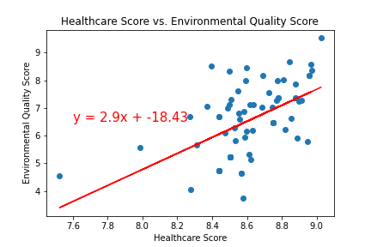
Notes:
We wanted to see if Taylor will get better healthcare in the cities with better environmental quality, and we found that overall the two scores DO correlate. If a city ranks high for environment, she’s going to be able to access better healthcare in most cases. The correlation, however, is somewhat weak so we can’t say that there is a definitive link between the two.

Slide 7
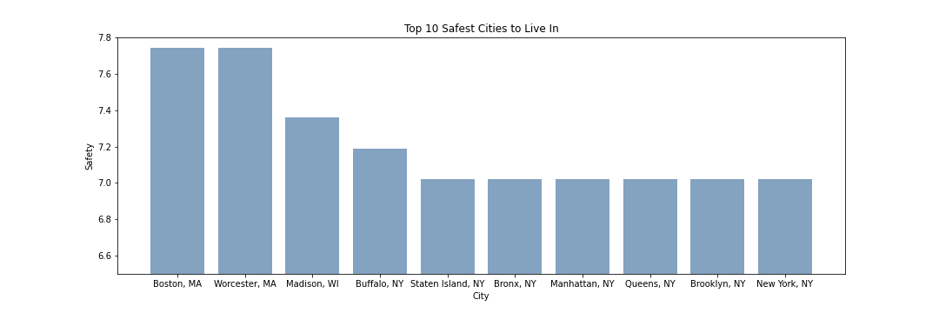
Safest Cities
Notes:
Another important factor to Taylor is Safety. She’d rather be able to go out in her community without constant vigilance. The safest cities are actually both in Massachusetts, Boston and Worcester. They’re followed by Madison, WI which also had ranked well in environmental quality. Madison is looking pretty nice so far.
These rankings are based on Crime-Rate, Gun related deaths, and number of guns per resident, so the safety rankings are different than some other sources by taking in multiple factors.

Slide 8
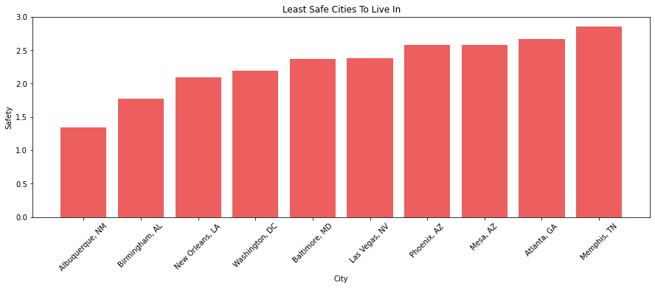
Least Safe Cities
Notes:
The least safe cities we studied in the US are Albuquerque, NM, Birmingham, AL, New Orleans, LA, Washington DC and Baltimore MD. Taylor doesn’t want to move to any of these places because she has already been burgled enough times in her life.

Slide 9
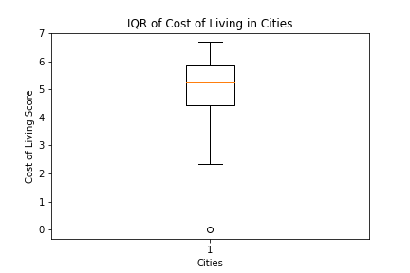
Cost of Living Outliers
Notes:
Cost of living is really important to Taylor, so first things first we wanted to check if there were any outliers in the data. We found one distinct outlier and determined that there was No Ranking on Teleport for cost of living in that city.
As we know, the outlier does not change the IQR, and we didn’t want to live in Rhode Island anyway.

Slide 10
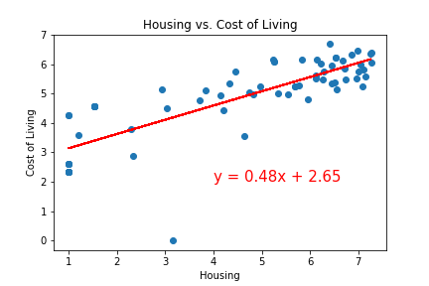
Housing and Cost of Living
R=0.81
Notes:
We wanted to know if Housing prices and home goods were generally correlated. This data is based on scores so a higher score means LOWER housing and cost of living costs, whereas lower scores are more expensive.
Wouldn’t you know it, they are very well correlated. The R value on this regression is 0.81, making it a strong correlation. On our previous scatterplot comparing Healthcare and Environmental Quality the R Value was 0.54, showing a much weaker correlation between those factors.

Slide 11
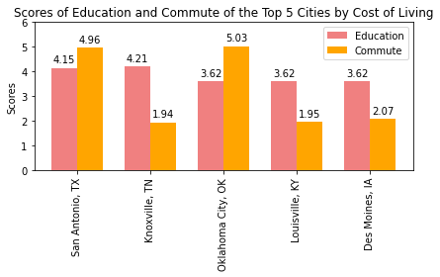
Education and Commute in Best Cost of Living Locations
Notes:
Since we now have the top 5 cities for Cost of Living, San Antonio TX, Knoxville, TN, Oklahoma City, OK , Louisville, KY, Des Moines, IA, we wanted to see how they compared in Education and Commute. These factors are less important but can still affect Taylor’s decision to relocate.
Based on these factors, Taylor will be Anthony’s neighbor and available for dogsitting during future cruises.

Slide 12
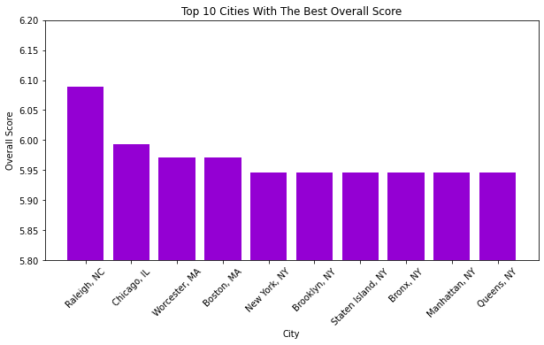
Overall City Scores
Notes:
Teleport has scores for 17 different factors, so found the average of all scores for each city and charted the top 10 cities to see how they compared to Taylor’s factors. A few cities like Raleigh and Worcester ranked well on both, but factors that Taylor didn’t care about (mostly business related like start up and venture capital) have several cities in New York on Teleport’s top 10.

Slide 13
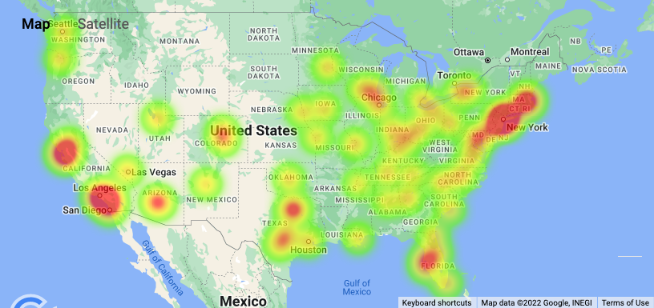
Overall Scores
Notes:
The heatmap of overall scores shows that generally coastal areas have higher scores, but there are good places to live more centrally in Texas and around the Great Lakes.

Slide 14

Top 5 Cities by Overall Score
Raleigh, NC
Chicago, IL
Worcester, MA
Boston, MA
New York, NY

Slide 15

Worcester, MA Wins!
Notes:
Worcester, MA ranks in the top 5 in several of our factors including Safety, Education, and Overall Scores. It’s also top 10 in Taylor’s top factor of environmental quality, Taylor will be moving to Worcester! She’s looking forward to a town with a lot of history. She’ll enjoy spending the day at the botanical gardens, followed by a visit to the many breweries.
Honorable mentions include Madison, WI, Raleigh, NC and Des Moines, IA. Madison is also a strong contender because it ranked so well in Taylor’s top factor of environmental quality.

Slide 16
Data Source: Teleport
Teleport builds software aiming to create free movement of talent (employees) so governments will compete for citizens.
Ratings aim to connect people to the best place to live based on their preferences
Teleport is owned by Topia, a technology company for managing distributed and remote workforces
Shortcomings

